Slide 1
Outland Adventures
Group 1
Database Development and Use
A case study
And a solution

Slide 2
Introduction
Contributors:
Phillip Thoendel
Alexis Simmons
Tej Chudali
Clay Lankford
Alexis Yang
This presentation will serve as a guide for our case study. We will discuss a set of business problems and our collectively reached solutions.

Slide 3
Welcome, adventure…
Outland Adventures is a growing outdoor adventure company, with room for improvement.

Slide 4
Problems to Solve
Are equipment sales viable to continue, or is a “rent only” model a better option?
How old is the current equipment?
Are certain trek destinations becoming less popular over time?
Outland Adventures had some specific business problems to solve.

Slide 5
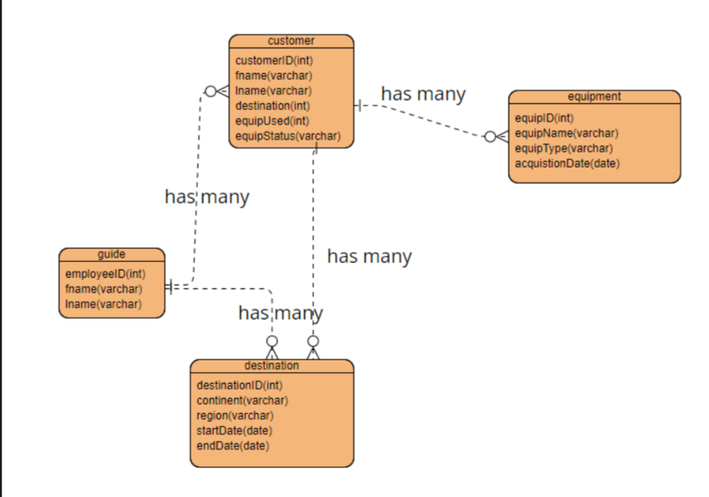
Clarified ERD
To provide a timely solution, the scope of the ERD was limited to key areas
The ERD adds tangibility to an otherwise abstract problem set.
has many
has many
has many
has many

Slide 6
Assumptions
Each customer only has one equipment used listed in our database.
Booking trends are based on continents, not regions.
Guides have received proper training and certifications.
Customers will prefer a combination of renting and buying equipment.
Decline in certain travel locations is not due to political unrest or other unsafe conditions.

Slide 7
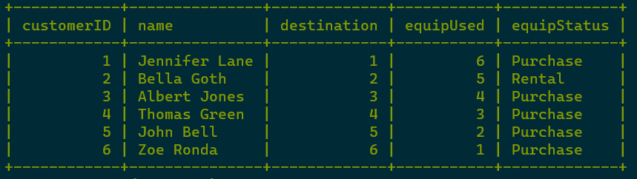
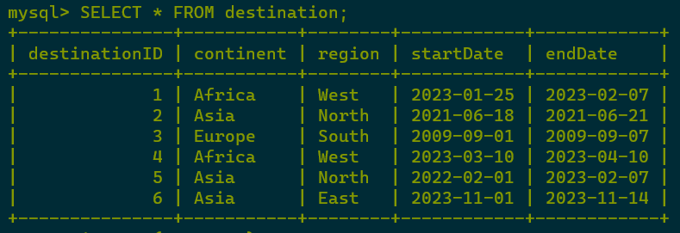
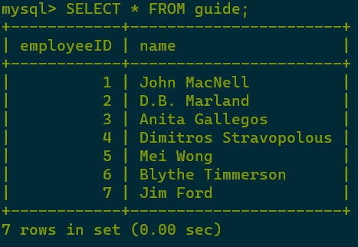
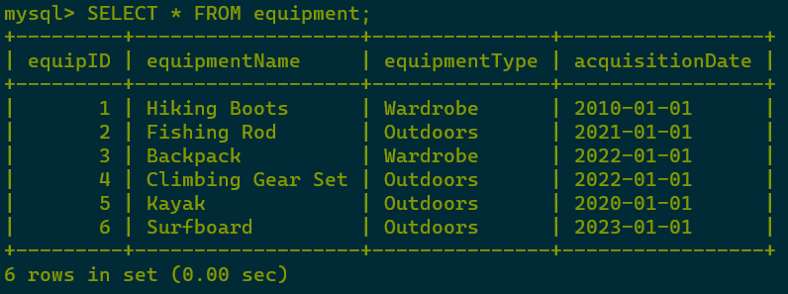
Table Creation
SQL Tables
A script was written to build and populate tables in SQL.

Slide 8
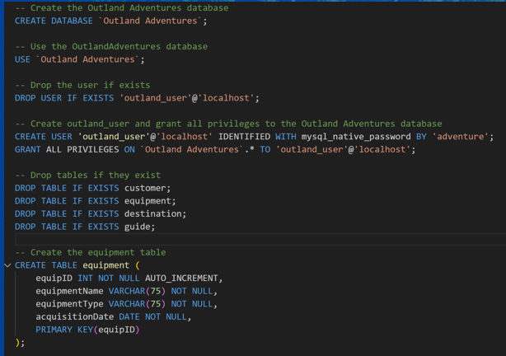
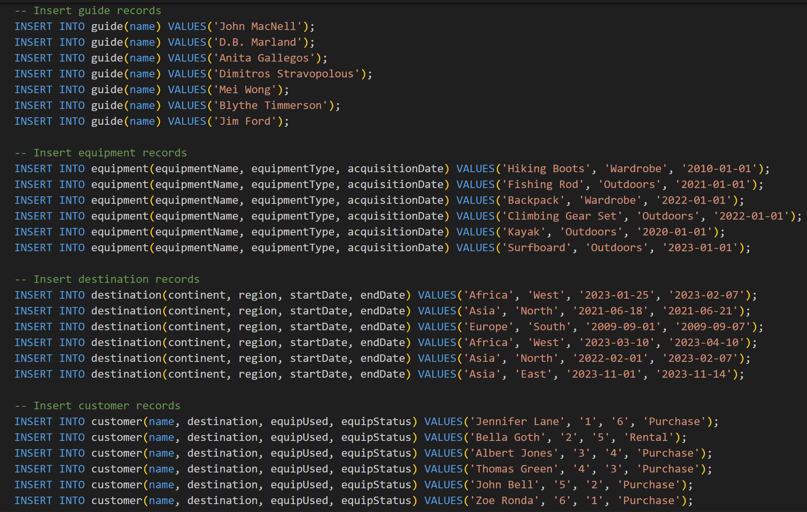
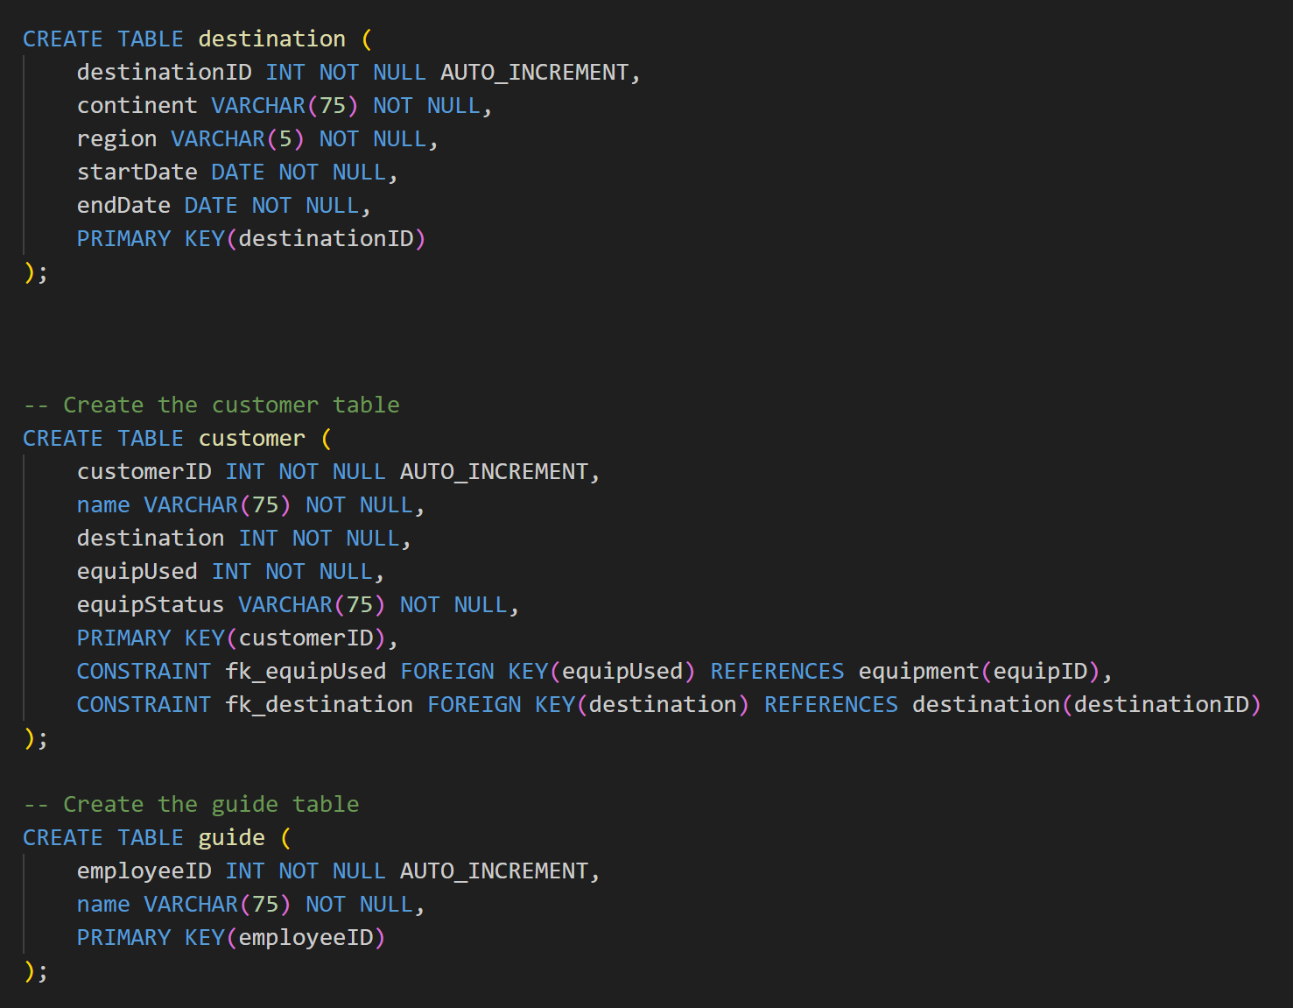
The Script

Slide 9
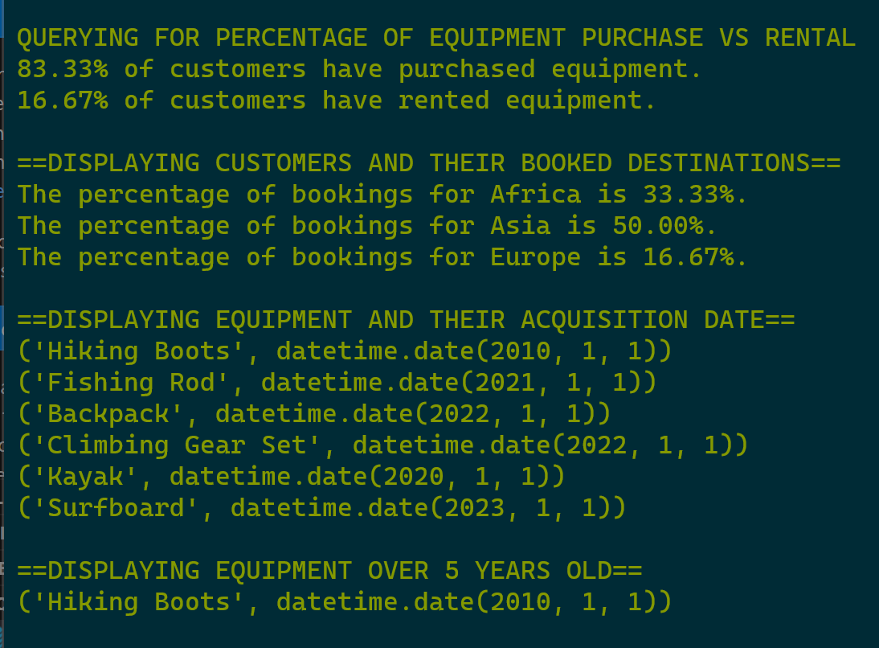
Solution 1
Script Output
A Python script was written to run SQL commands and print output.

Slide 10
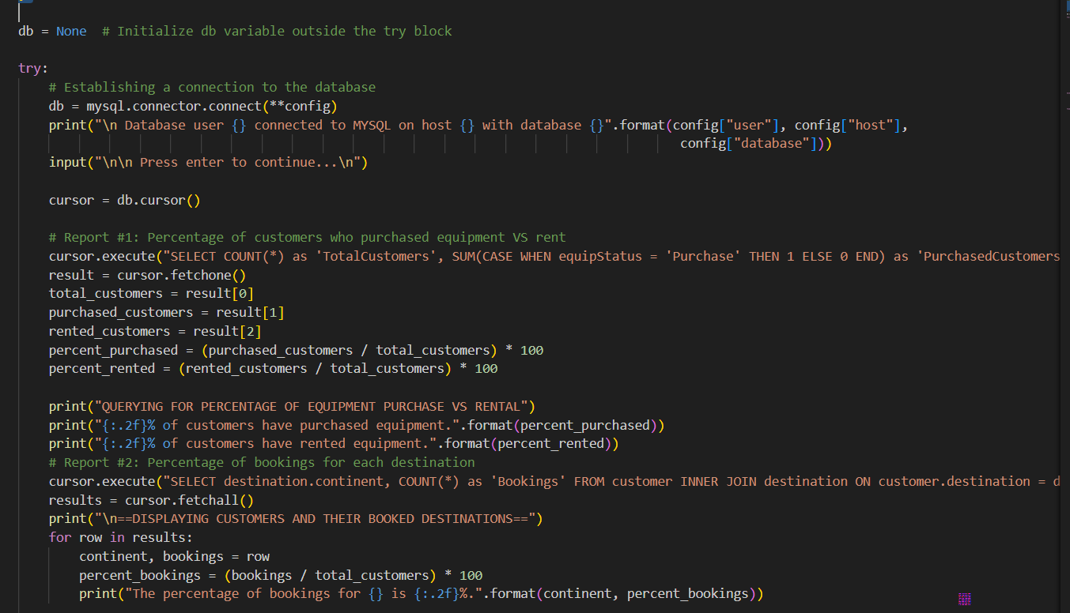
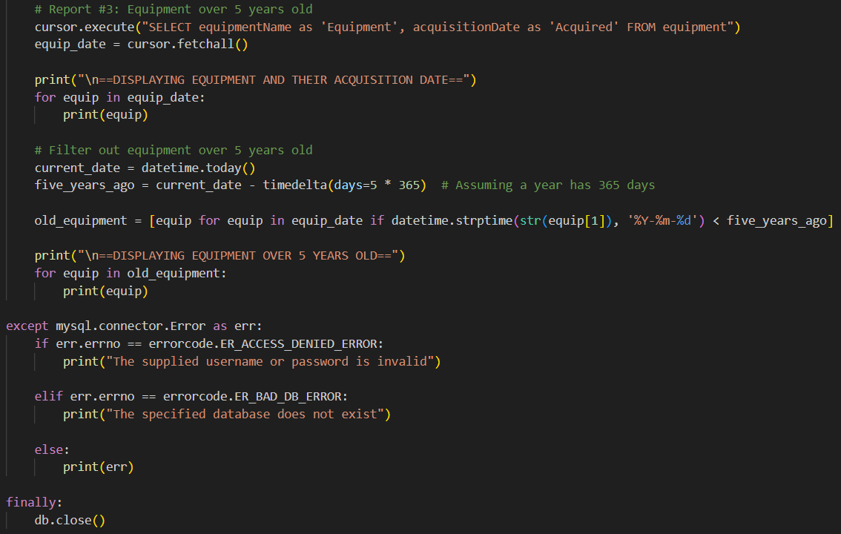
The Script

Slide 11
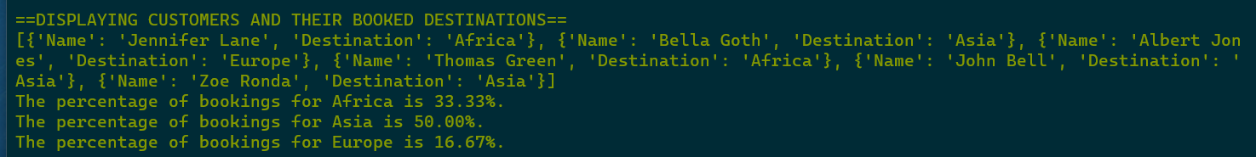
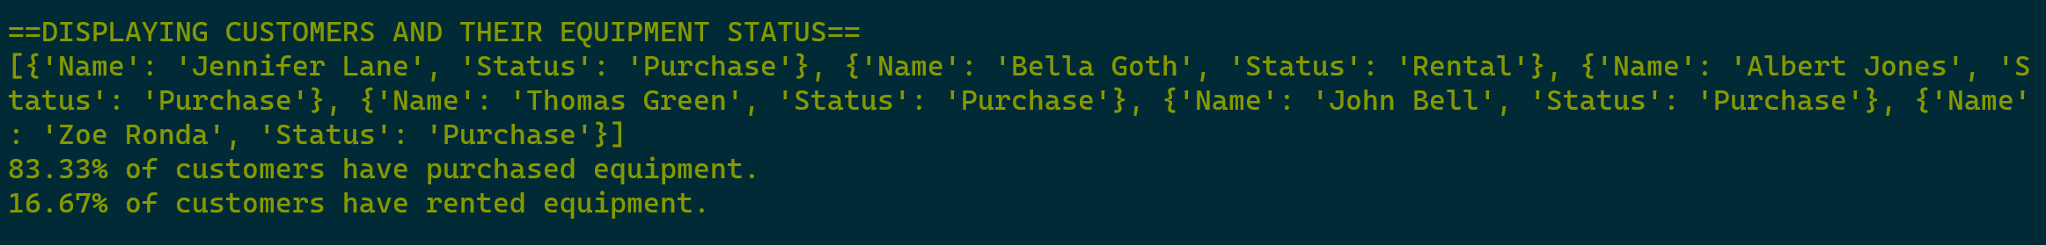
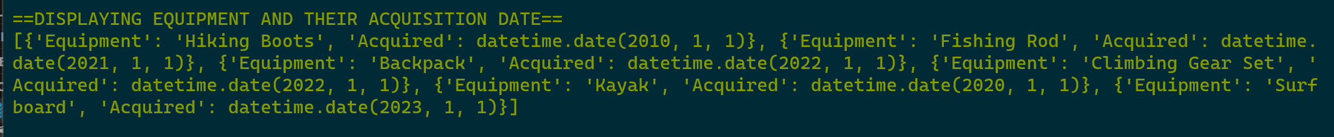
Solution II
Script Output
A python script stored SQL data as tuples/dictionaries for a single platform manipulation

Slide 12
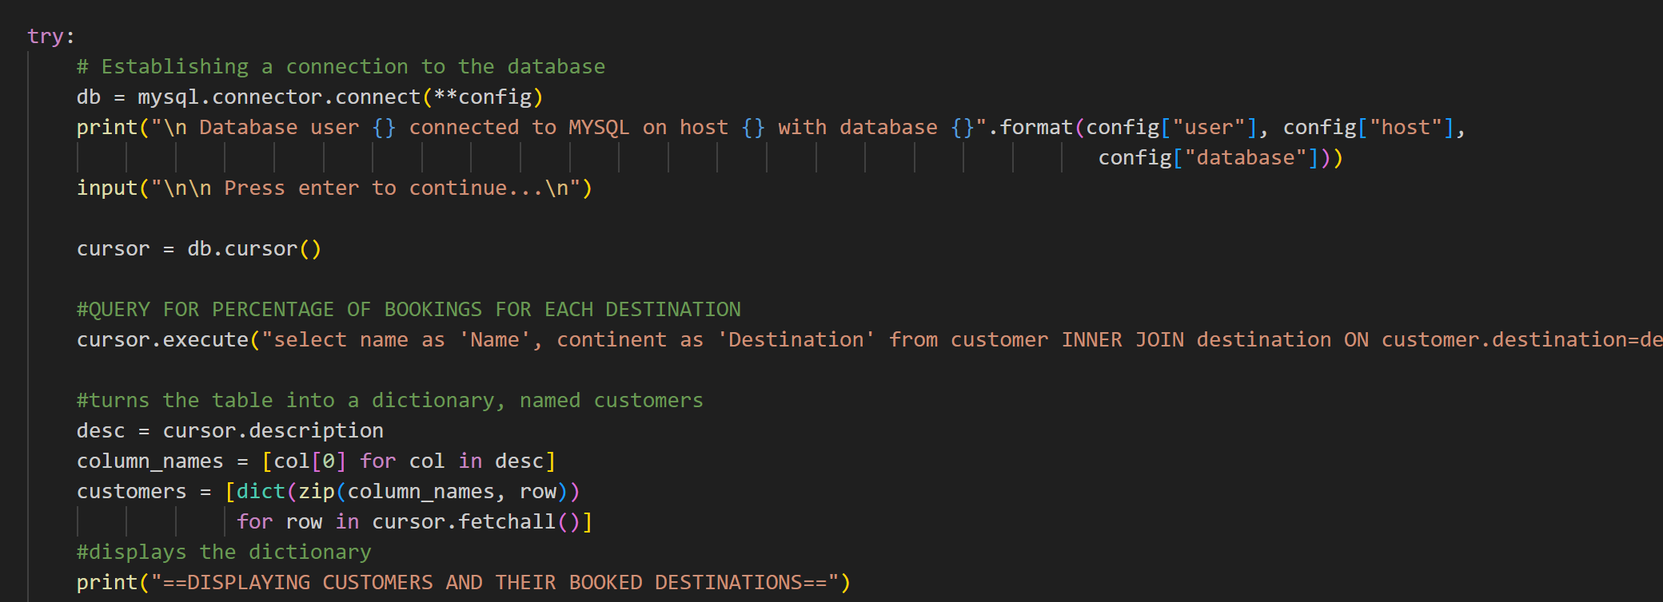
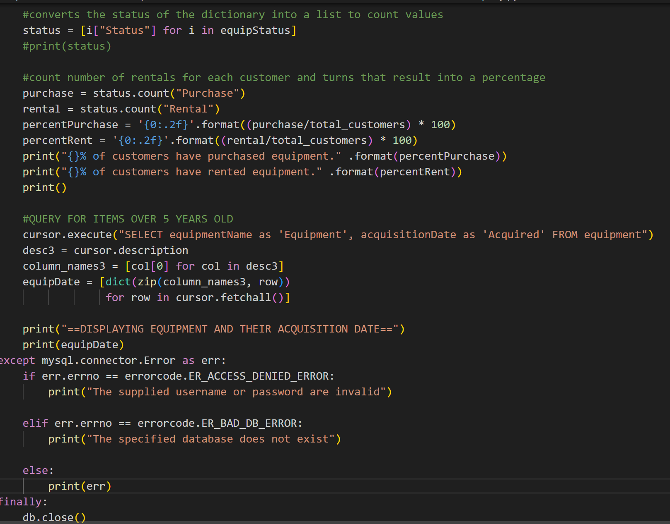
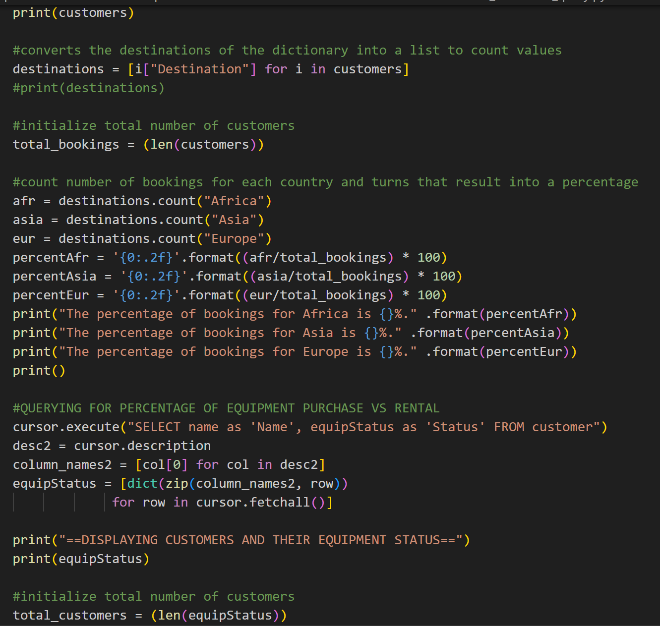
The Script

Slide 13
Company Takeaways
Outland Adventures is a young company, the reports we have created will provide analysis to make important decisions as they grow.
Should destination offerings be expanded in Southern Europe? Should equipment sales be discontinued? Expansion of rentals?
How long should equipment be used before removing from inventory?

Slide 14
Thank you
Now that Outland Adventures has the information they need they can make informed decisions about their organization!

